Slide 1
Cryptography and Computer Security (CSS) Lecture # 2

Slide 2
Introduction to CSS Course (CS401)

Slide 3
Unit I Introduction to Security and Cryptography
OSI Security Architecture
Security Attacks
Security Services
Security Mechanism
Symmetric Cipher Model
Cryptography
Cryptanalysis & Attacks
Substitution Techniques
Transposition Techniques

Slide 4
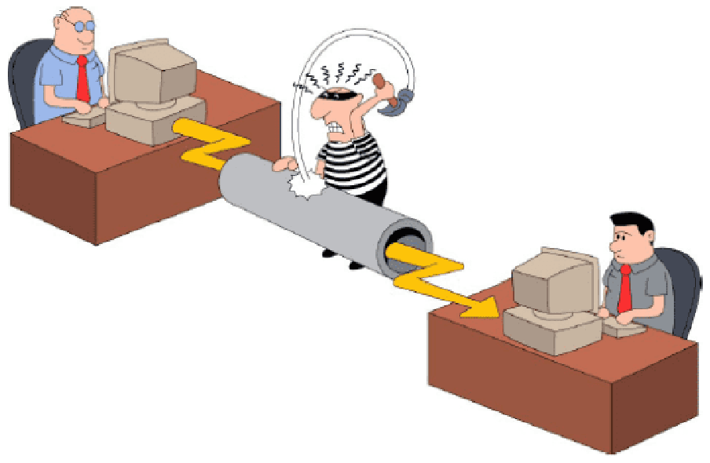
Introduction to Information & N/W Security

Slide 5
OSI Security Architecture
The OSI (Open Systems Interconnection) security architecture focuses on Security Attacks, Mechanisms, and Services.
Security Attack: Any action that compromises the security of information owned by an organization.
Security Mechanism: A process that is designed to detect, prevent, or recover from a security attack.
Security Service: A service that enhances the security of the data processing systems and the information transfers of an organization using one or many security mechanisms.

Slide 6
Security Attacks
A passive attack attempts to learn or make use of information from the system but does not affect system resources.
Release of message contents
Traffic analysis
An active attack attempts to alter system resources or affect their operation.
Masquerade
Replay
Modification of messages
Denial of service.

Slide 7
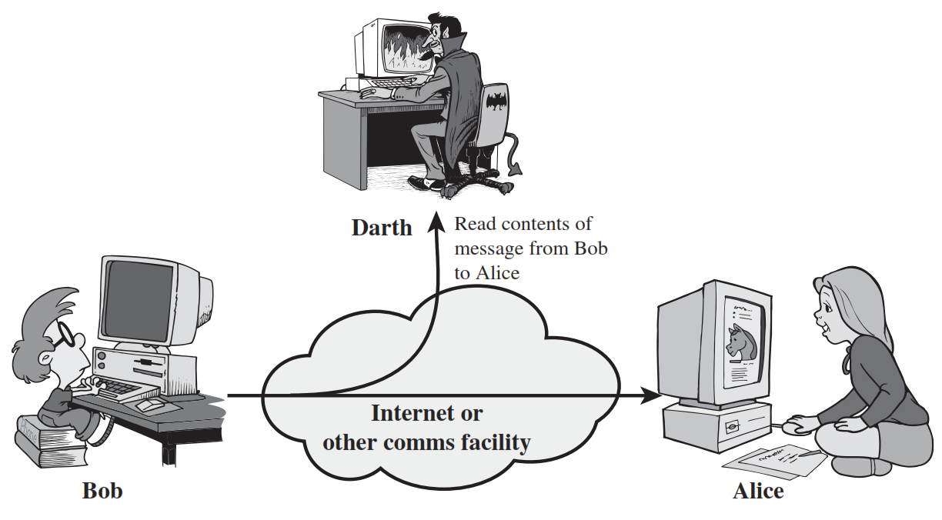
1) Release of message contents (Passive Attack)
A telephone conversation, an electronic mail message, and a transferred file may contain sensitive or confidential information.
We would like to prevent an opponent from learning the contents of these transmissions.

Slide 8
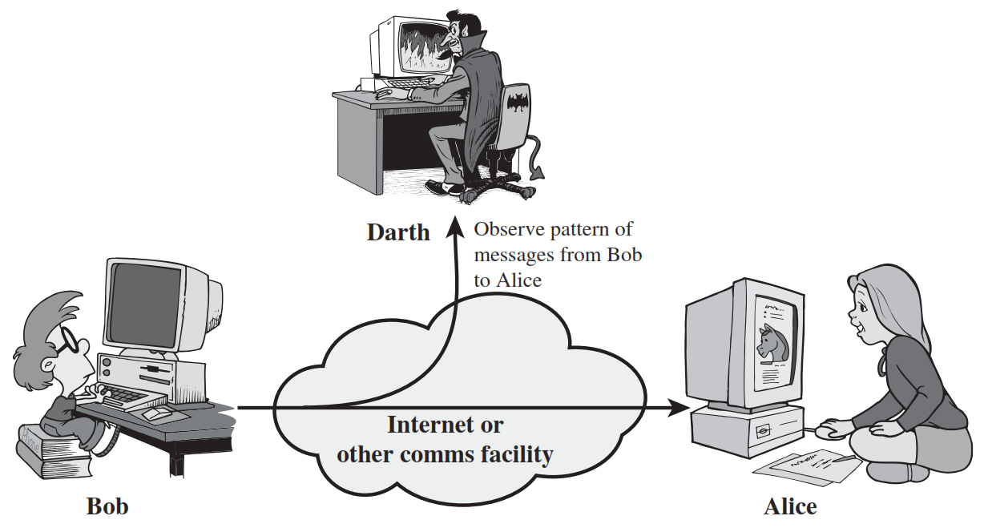
2) Traffic Analysis (Passive Attack)
In such attacks, an adversary, capable of observing network traffic statistics in several different networks, correlates the traffic patterns in these networks.

Slide 9
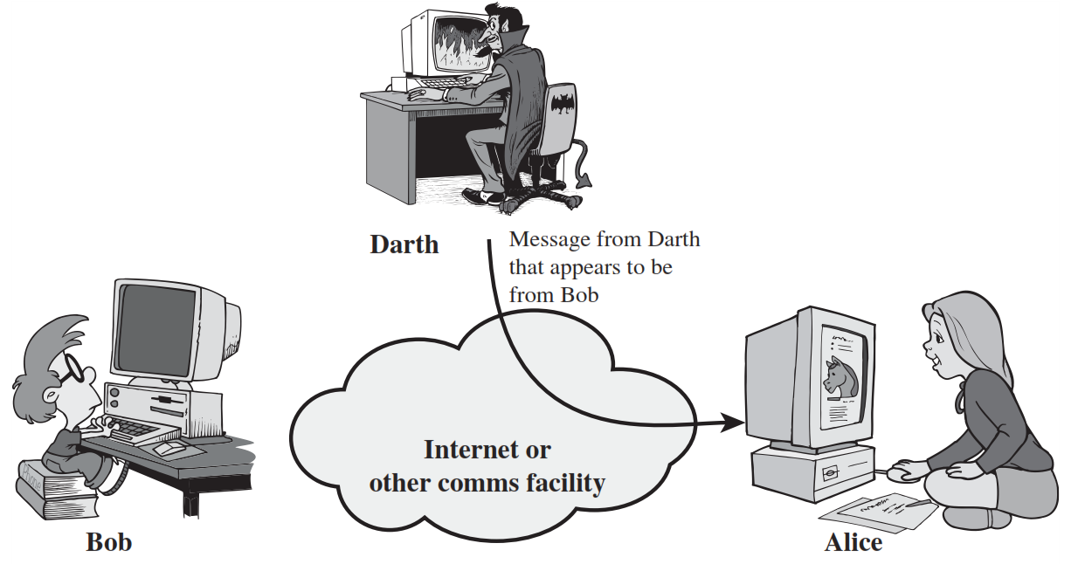
1) Masquerade Attack (Active Attack)
A masquerade takes place when one entity pretends to be a different entity.

Slide 10

2) Replay Attack (Active Attack)
Replay attack involves the passive capture of a data unit and its subsequent retransmission to produce an unauthorized effect.

Slide 11
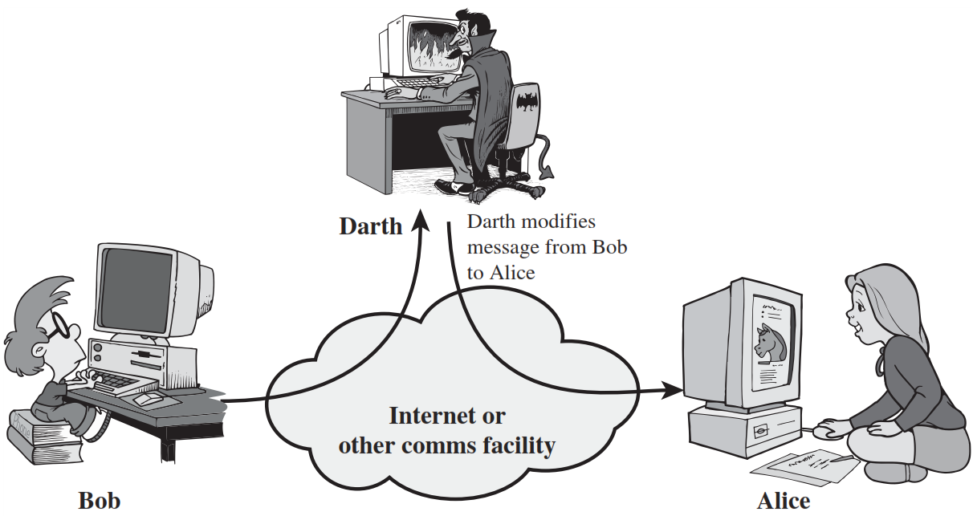
3) Modification of messages Attack (Active Attack)
Modification of messages simply means that some portion of a legitimate message is altered, or that messages are delayed or reordered, to produce an unauthorized effect.

Slide 12
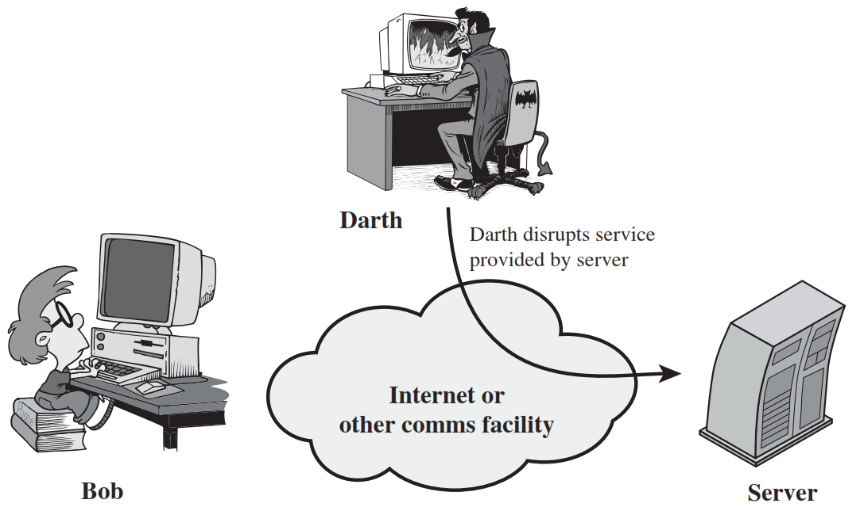
4) Denial of Service Attack (Active Attack)
The denial of service attack prevents the normal use or management of communications facilities.

Slide 13
Security Services (X.800)
X.800 standard defines a security service as a service that is provided by a protocol layer of communicating open systems and that ensures security of the systems or of data transfers.
Notes:
a processing or communication service that is provided by

Slide 14
Security Services
Authentication
Access Control
Data Confidentiality
Data Integrity
Non Repudiation
Peer Entity Authentication
Connection Confidentiality
Connection Integrity with recovery
Non Repudiation Origin
Data Origin Authentication
Connection less Confidentiality
Connection Integrity with out recovery
Non Repudiation Destination
Selective Repeat Confidentiality
Selective Field Connection Integrity
Traffic Flow Confidentiality
Connection less Integrity
Selective Field Connection less Integrity

Slide 15
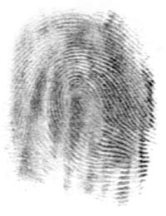
Authentication
Authentication is the assurance that the communicating entity is the one that it claims to be.
Who you are ? (biometrics)
Peer Entity Authentication: Used in association with a logical connection to provide confidence in the identity of the entities connected.
Data-Origin Authentication: In a connectionless transfer, provides assurance that the source of received data is as claimed.
Physical authentication
where you are ?
What you know ?
Password
One-time Passwords
Network address
Notes:
Peer Entity Authentication: Used in association with a logical connection to provide confidence in the identity of the entities connected.
Data-Origin Authentication: In a connectionless transfer, provides assurance that the source of received data is as claimed.

Slide 16
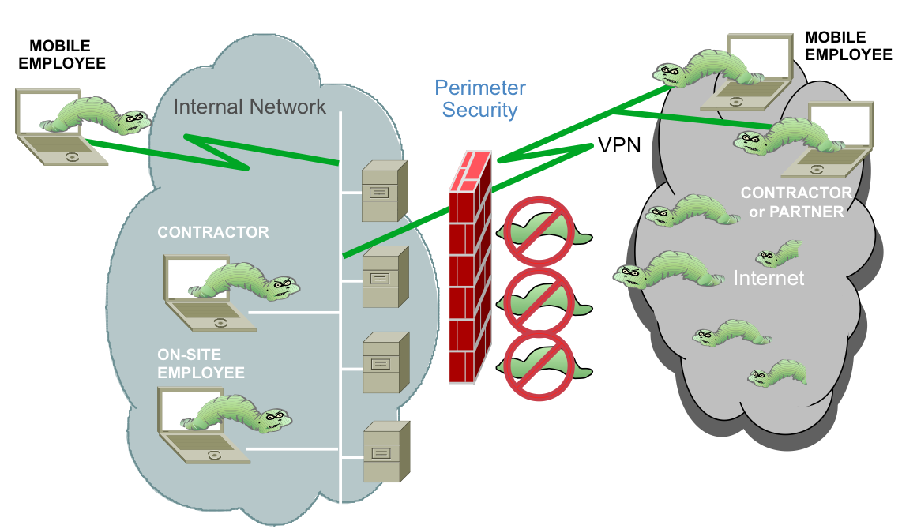
Access Control
Access control is the prevention of unauthorized use of a resource
This service controls who can have access to a resource, under what conditions access can occur, and what those accessing the resource are allowed to do).

Slide 17
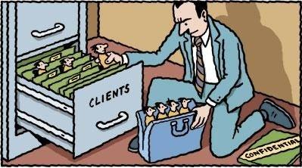
Data Confidentiality
Data confidentiality is the protection of data from unauthorized disclosure.
Connection Confidentiality: The protection of all user data on a connection.
Connectionless Confidentiality: The protection of all user data in a single data block.
Selective-Field Confidentiality: The confidentiality of selected fields within the user data on a connection or in a single data block.
Traffic-Flow Confidentiality: The protection of the information that might be derived from observation of traffic flows.

Slide 18
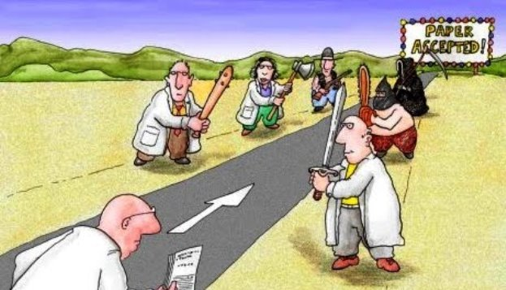
Data Integrity
Data integrity is the assurance that data received are exactly as sent by an authorized entity (i.e., contain no modification, insertion, deletion, or replay).

Slide 19
Data Integrity (Cont…)
Connection Integrity with Recovery: Provides integrity of all user data on a connection and detects any modification, insertion, deletion, or replay of any data with recovery attempted.
Connection Integrity without Recovery: As above, but provides only detection without recovery.
Selective-Field Connection Integrity: Provides integrity of selected fields within the user data and takes the form of determination of whether the selected fields have been modified, inserted, deleted, or replayed.

Slide 20
Data Integrity (Cont…)
Connectionless Integrity: Provides integrity of a single connectionless data block and may take the form of detection of data modification. Additionally, a limited form of replay detection may be provided.
Selective-Field Connectionless Integrity: Provides integrity of selected fields within a single connectionless data block; takes the form of determination of whether the selected fields have been modified.

Slide 21


Non Repudiation
Nonrepudiation is the assurance that someone cannot deny something.
Typically, nonrepudiation refers to the ability to ensure that a communication cannot deny the authenticity of their signature on a document or the sending of a message that they originated.
Transfer Rs. 1,00,000
To Bank
After few days
User A
I have never requested to transfer Rs. 1,00,000
to Bank
Bank
Notes:
Hash functions, Digital signatures

Slide 22
Non Repudiation (Cont…)
Nonrepudiation-Origin: Proof that the message was sent by the specified party.
Nonrepudiation-Destination: Proof that the message was received by the specified party.

Slide 23
Security Mechanisms (X.800)
Specific security mechanisms: Integrated into the appropriate protocol layer in order to provide some of the OSI security services.
Pervasive security mechanisms: Not integrated to any particular OSI security service or protocol layer

Slide 24
Security Mechanism (Specific Security)
Encipherment: Hiding or covering data using mathematical algorithms.
Digital Signature: The sender can electronically sign the data and the receiver can electronically verify the signature.
Access Control: A variety of mechanisms that enforce access rights to resources.
Data Integrity: A variety of mechanisms used to assure the integrity of a data unit or stream of data units.
Authentication Exchange: Two entities exchange some messages to prove their identity to each other.

Slide 25
Security Mechanism (Specific security)
Traffic Padding: The insertion of bits into gaps in a data stream to frustrate traffic analysis attempts.
Routing Control: Selecting and continuously changing routes between sender and receiver to prevent opponent from eavesdropping.
Notarization: The use of a trusted third party to assure and control the communication.

Slide 26
Model for Network Security
Trusted third party
(e.g., arbiter, distributer
of secret information)
Sender
Recipient
Security -related Transformation
Info.
Channel
Security -related Transformation
Message
Secure
Message
Secure
Message
Message
Secret
Information
Secret
Information
Opponent

Slide 27
Encryption and Decryption
Sender
Hello
Encryption
f7#er
Decryption
Hello
Receiver

Slide 28



Symmetric Cipher Model (Conventional Encryption)
Secret key shared by sender and recipient
Secret key shared by sender and recipient
K
K
Transmitted
cipher text
Y = E(K, X)
X
X
Plaintext
input
Encryption Algorithm
(e.g. AES)
Decryption Algorithm
(reverse of encryption algorithm)
Plaintext
output
Plaintext is the original intelligible message or data that is fed into the algorithm as input.
Encryption algorithm performs various substitutions and transformations on the plaintext.
The secret key is also input to the encryption algorithm.
The key is a value independent of the plaintext and of the algorithm.
The algorithm will produce a different output depending on the specific key being used at the time.
Decryption algorithm is essentially the encryption algorithm run in reverse.
It takes the ciphertext and the secret key and produces the original plaintext.
Ciphertext is the scrambled message produced as output.
It depends on the plaintext and the secret key.
The ciphertext is an apparently random stream of data and, as it stands, is unintelligible.
An original message is known as the plaintext, while the coded message is called the ciphertext.
The process of converting from plaintext to ciphertext is known as enciphering or encryption; restoring the plaintext from the ciphertext is deciphering or decryption.

Slide 29
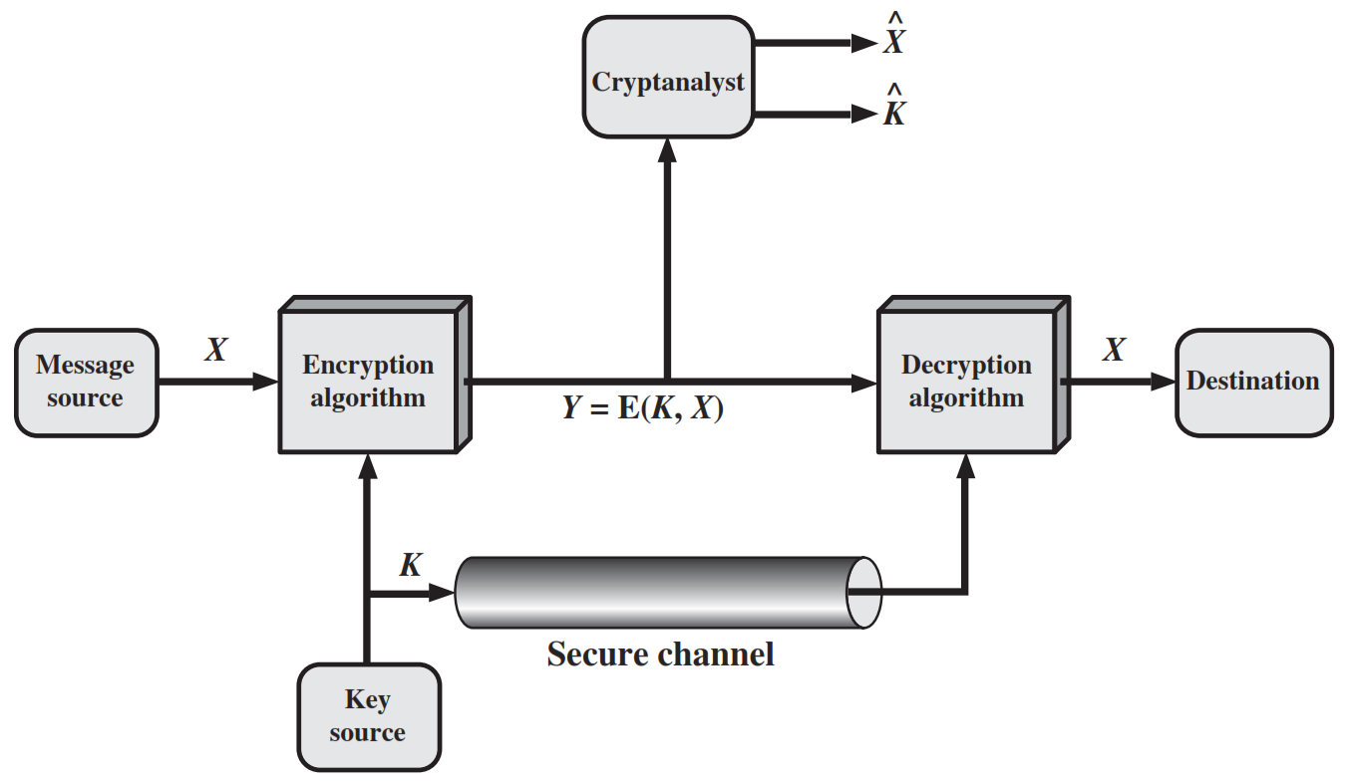
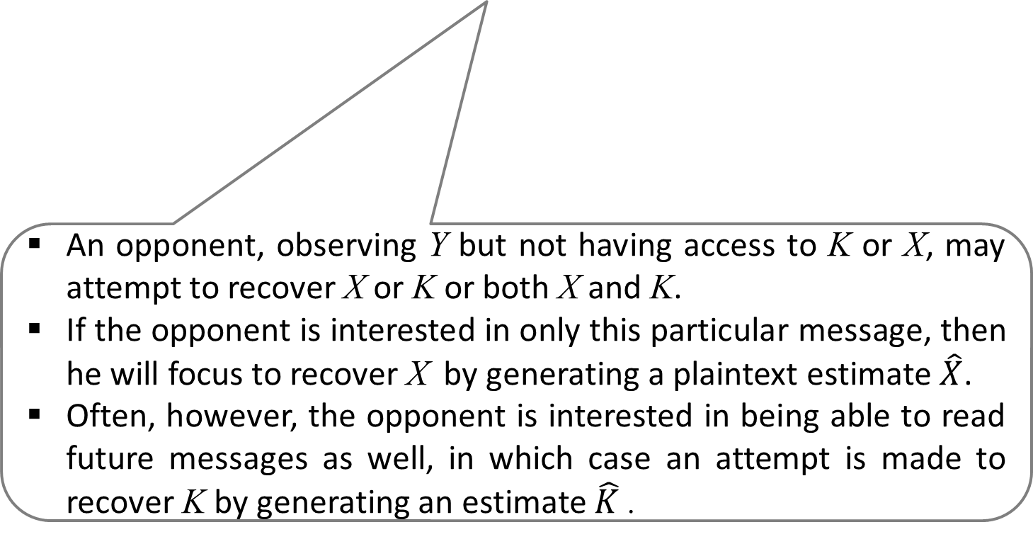
An opponent, observing Y but not having access to K or X, may attempt to recover X or K or both X and K.
If the opponent is interested in only this particular message, then he will focus to recover X by generating a plaintext estimate $\hat{X}$.
Often, however, the opponent is interested in being able to read future messages as well, in which case an attempt is made to recover K by generating an estimate $\hat{K}$.

Slide 30
Cryptanalysis and Brute-Force Attack
Cryptanalysis: Cryptanalytic attacks rely on the nature of the algorithm and some knowledge of the general characteristics of the plaintext or even some sample plaintext–ciphertext pairs.
This type of attack exploits the characteristics of the algorithm to attempt to derive a specific plaintext or to derive the key being used.
Brute-force attack: The attacker tries every possible key on a piece of ciphertext until an intelligible translation into plaintext is obtained.
On average, half of all possible keys must be tried to achieve success.

Slide 31
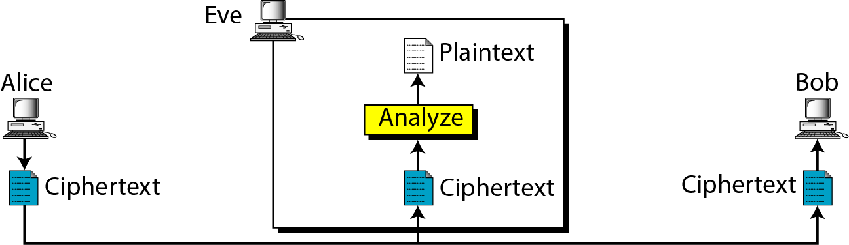
Attacks on Encrypted Messages
Type of Attack | Known to cryptanalyst
Ciphertext Only | Encryption algorithm, Ciphertext

Slide 32
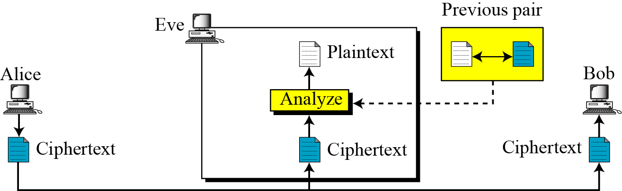
Attacks on Encrypted Messages
Type of Attack | Known to cryptanalyst
Known Plaintext | Encryption algorithm, Ciphertext, One or more plaintext-cipher text pairs formed with the secret key

Slide 33
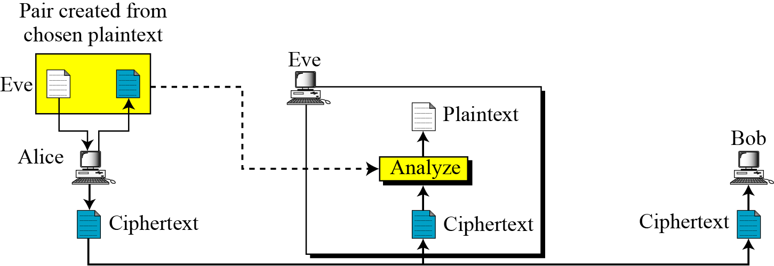
Attacks on Encrypted Messages
Type of Attack | Known to cryptanalyst
Chosen Plaintext | Encryption algorithm, Ciphertext, Plaintext message chosen by cryptanalyst

Slide 34
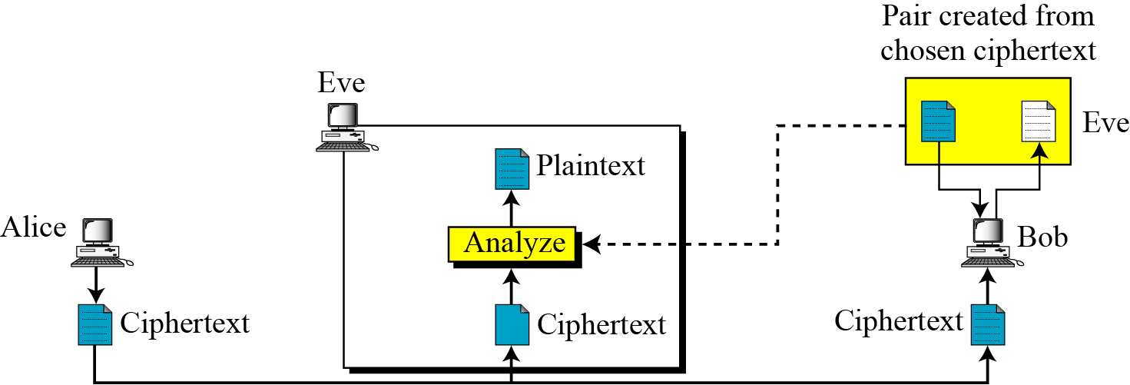
Attacks on Encrypted Messages
Type of Attack | Known to cryptanalyst
Chosen Ciphertext | Encryption algorithm, Ciphertext, Ciphertext chosen by cryptanalyst, with its corresponding decrypted plaintext generated with the secret key

Slide 35
Attacks on Encrypted Messages
Type of Attack | Known to cryptanalyst
Chosen text | Encryption algorithm, Ciphertext, Plaintext chosen by cryptanalyst, with its corresponding ciphertext generated with the secret key , Ciphertext chosen by cryptanalyst, with its corresponding decrypted plaintext generated with the secret key

Slide 36
Substitution Techniques
A substitution technique is one in which the letters of plaintext are replaced by other letters or by numbers or symbols.
Caesar Cipher
Monoalphabetic Cipher
Playfair Cipher
Hill Cipher
Polyalphabetic Ciphers
One-Time Pad

Slide 37
1) Caesar Cipher
The Caesar cipher involves replacing each letter of the alphabet with the letter standing three places further down the alphabet.
In encryption each plaintext letter P, substitute the ciphertext letter C:
For decryption algorithm is:
C = E(k, P) = (P + k) mod 26
C = E(3, P) = (P + 3) mod 26
P = D(k, C) = (C - k) mod 26
P = D(3, C) = (C - 3) mod 26

Slide 38
Caesar Cipher (Cont…)
Let us assign a numerical equivalent to each letter
a | b | c | d | e | f | g | h | i | j | k | l | m
0 | 1 | 2 | 3 | 4 | 5 | 6 | 7 | 8 | 9 | 10 | 11 | 12
n | o | p | q | r | s | t | u | v | w | x | y | z
13 | 14 | 15 | 16 | 17 | 18 | 19 | 20 | 21 | 22 | 23 | 24 | 25
C = E(3, P) = (P + 3) mod 26
plain: a b c d e f g h i j k l m n o p q r s t u v w x y z
cipher: d e f g h i j k l m n o p q r s t u v w x y z a b c
Example:
Plaintext: THE QUICK BROWN FOX
Ciphertext: WKH TXLFN EURZQ IRA

Slide 39
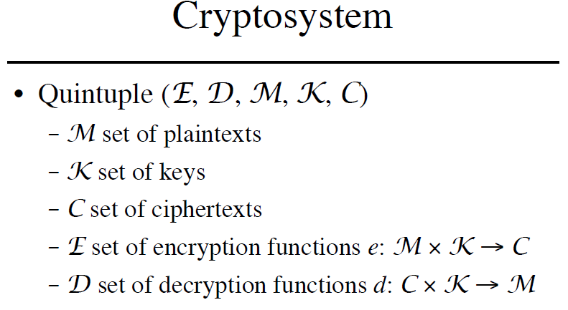
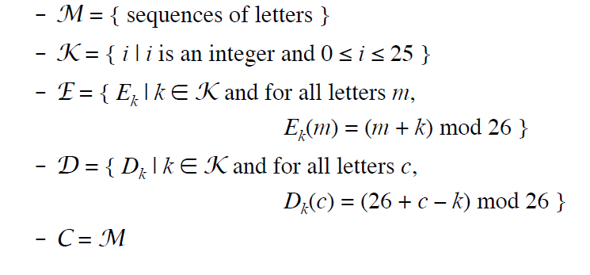
Brute force attack on Caesar Cipher
The encryption and decryption algorithms are known.
There are only 25 keys to try.
The language of the plaintext is known and easily recognizable.

Slide 40
Brute force attack on Caesar Cipher
Ciphertext: ZNK WAOIQ HXUCT LUD
Key | Transformed text
1 | YMJ VZNHP GWTBS KTC
2 | XLI UYMGO FVSAR JSB
3 | WKH TXLFN EURZQ IRA
4 | VJG SWKEM DTQYP HQZ
5 | UIF RVJDL CSPXOGPY
6 | THE QUICK BROWN FOX
7 | SGD PTHBJ AQNVM ENW
8 | RFC OSGAI ZPMUL DMV
9 | QEB NRFZH YOLTK CLU
10 | PDA MQEYG XNKSJ BKT
11 | OCZ LPDXF WMJRI AJS
12 | NBY KOCWE VLIQH ZIR
13 | MAX JNBVD UKHPG YHQ
Key | Transformed text
14 | LZW IMAUC TJGOF XGP
15 | KYV HLZTB SIFNE WFO
16 | JXU GKYSA RHEMD VEN
17 | IWT FJXRZ QGDLC UDM
18 | HVS EIWQY PFCKB TCL
19 | GUR DHVPX OEBJA SBK
20 | FTQ CGUOW NDAIZ RAJ
21 | ESP BFTNV MCZHY QZI
22 | DRO AESMU LBYGX PYH
23 | CQN ZDRLT KAXFW OXG
24 | BPM YCQKS JZWEV NWF
25 | AOL XBPJR IYVDU MVE

Slide 41
Substitution Techniques
Caesar Cipher
Monoalphabetic Cipher
Playfair Cipher
Hill Cipher
Polyalphabetic Ciphers
One-Time Pad

Slide 42
2) Monoalphabetic Cipher (Simple substitution)
It is an improvement to the Caesar Cipher.
Instead of shifting the alphabets by some number, this scheme uses some permutation of the letters in alphabet.
The sender and the receiver decide on a randomly selected permutation of the letters of the alphabet.
With 26 letters in alphabet, the possible permutations are 26! which is equal to 4x1026.
plain: a b c d e f g h i j k l m n o p q r s t u v w x y z
cipher: y n l k x b s h m i w d p j r o q v f e a u g t z c

Slide 43
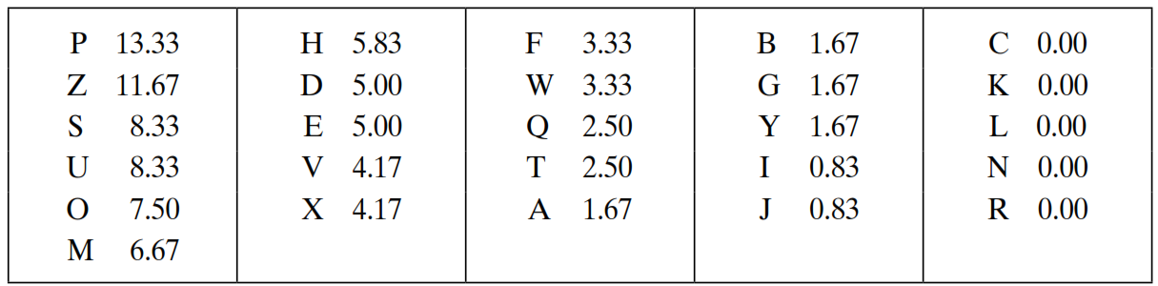
Attack on Monoalphabetic Cipher
Consider the ciphertext and relative frequencies of the letters (in percentages) as follows:
Ciphertext:
uzqsovuohxmopvgpozpevsgzwszopfpesxudbmetsxaizvuephzhmdzshzowsfpappdtsvpquzwymxuzuhsxepyepopdzszufpombzwpfupzhmdjudtmohmq
In our ciphertext, the most common digram is ZW, which appears three times. So equate Z with t, W with h and P with e.
Now notice that the sequence ZWP appears in the ciphertext, and we can translate that sequence as “the.”

Slide 44
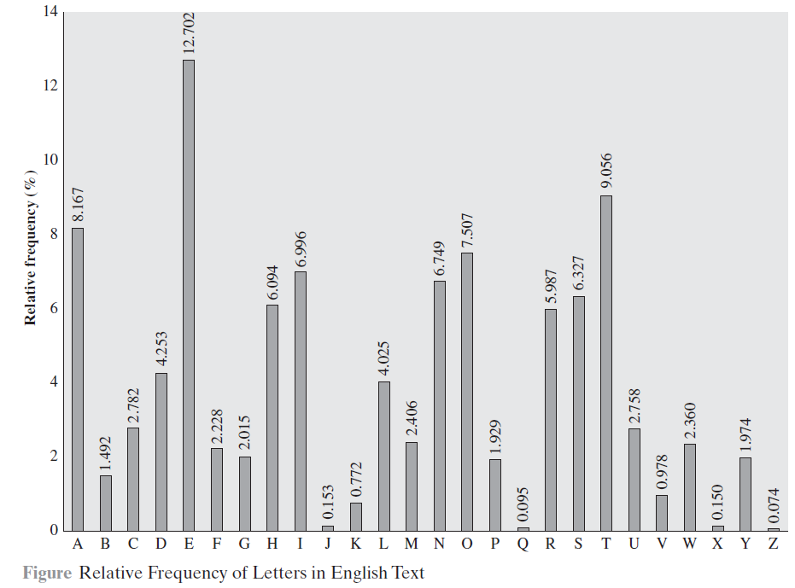
Attack on Monoalphabetic Cipher (Cont…)

Slide 45
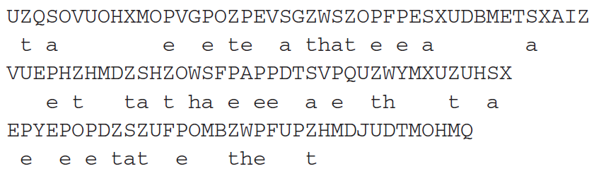
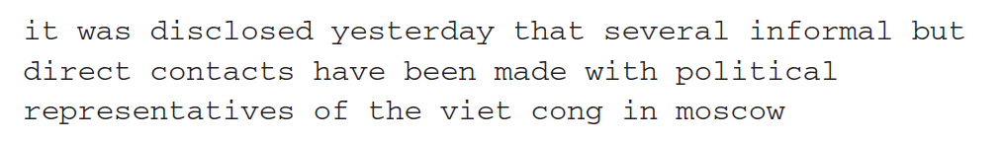
Attack on Monoalphabetic Cipher (Cont…)
If the cryptanalyst knows the nature of the plaintext, then the analyst can exploit the regularities of the language.
The relative frequency of the letters can be determined and compared to a standard frequency distribution for English.
If the message were long enough, this technique alone might be sufficient, but because this is a relatively short message, we cannot expect an exact match.

Slide 46
Substitution Techniques
Caesar Cipher
Monoalphabetic Cipher
Playfair Cipher
Hill Cipher
Polyalphabetic Ciphers
One-Time Pad

Slide 47
3) Playfair Cipher
The Playfair algorithm is based on a 5 × 5 matrix (key) of letters.
The matrix is constructed by filling in the letters of the keyword (minus duplicates) from left to right and from top to bottom, and then filling in the remainder of the matrix with the remaining letters in alphabetic order. The letters I and J count as one letter.
O | C | U | R | E
N | A | B | D | F
G | H | I/J | K | L
M | P | Q | S | T
V | W | X | Y | Z
Example:
Keyword= OCCURRENCE
Plaintext= TALL TREES

Slide 48
Playfair Cipher - Encrypt Plaintext
Playfair, treats digrams (two letters) in the plaintext as single units and translates these units into ciphertext digrams.
Make Pairs of letters add filler letter “X” if same letter appears in a pair.
If there is an odd number of letters, then add uncommon letter to complete digram, a X/Z may be added to the last letter.
Plaintext= TALL TREES
Plaintext= TA LX LT RE ES

Slide 49
Playfair Cipher - Encrypt Plaintext
Map each pair in key matrix
O | C | U | R | E
N | A | B | D | F
G | H | I/J | K | L
M | P | Q | S | T
V | W | X | Y | Z
Plaintext= TA LX LT RE ES
Ciphertext= PF IZ TZ EO RT
If the letters are on different rows and columns, replace them with the letters on other corner of the same row.
The order is important - the first letter of the pair should be replaced first.
For example, using the table above, the letter pair TA would be encoded as PF.
If the letters appear on the same row, replace them with the letters to their immediate right respectively, wrapping around to the left side of the row if necessary.
For example, using the table above, the letter pair RE would be encoded as EO.
If the letters appear on the same column, replace them with the letters immediately below, wrapping around to the top if necessary.
For example, using the table above, the letter pair LT would be encoded as TZ.

Slide 50
Playfair Cipher Examples
Key= “ engineering ” Plaintext=” test this process ”
Key= “ keyword ” Plaintext=” come to the window ”
Key= “ moonmission ” Plaintext=” greet ”
E N G I R A B C D F H K L M O P Q S T U V W X Y Z | Encrypted Message: pi tu pm gt ue lf gp xg
K E Y W O R D A B C F G H I L M N P Q S T U V X Z | Encrypted Message: lc nk zk vf yo gq ce bw
M O N I S A B C D E F G H K L P Q R T U V W X Y Z | Encrypted Message: hq cz du

Slide 51
Substitution Techniques
Caesar Cipher
Monoalphabetic Cipher
Playfair Cipher
Hill Cipher
Polyalphabetic Ciphers
One-Time Pad

Slide 52
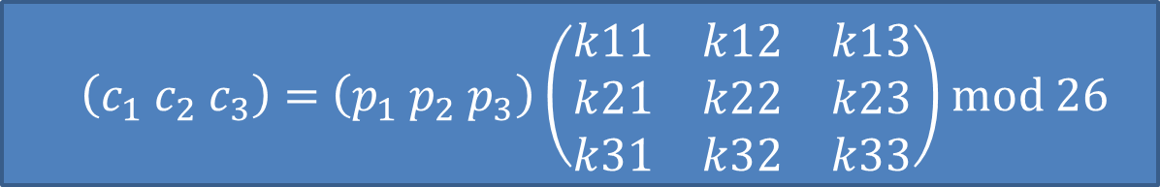
4) Hill Cipher
Hill cipher is based on linear algebra
Each letter is represented by numbers from 0 to 25 and calculations are done modulo 26.
Encryption and decryption can be given by the following formula:
Encryption:
Decryption:
C=PK mod 26
P=CK⁻¹ mod 26
$\left(c_{1} c_{2} c_{3}\right)=$$\left(p_{1} p_{2} p_{3}\right)\left(\begin{matrix}k11 & k12 & k13 \\ k21 & k22 & k23 \\ k31 & k32 & k33\end{matrix}\right)$mod 26

Slide 53
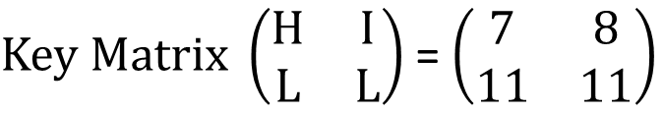
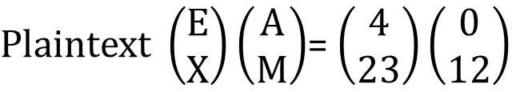
Hill Cipher Encryption
To encrypt a message using the Hill Cipher we must first turn our keyword and plaintext into a matrix (a 2 x 2 matrix or a 3 x 3 matrix, etc).
Example: Key = “HILL”, Plaintext = “EXAM”
a | b | c | d | e | f | g | h | i | j | k | l | m
0 | 1 | 2 | 3 | 4 | 5 | 6 | 7 | 8 | 9 | 10 | 11 | 12
n | o | p | q | r | s | t | u | v | w | x | y | z
13 | 14 | 15 | 16 | 17 | 18 | 19 | 20 | 21 | 22 | 23 | 24 | 25
$Key Matrix \left(\begin{matrix}H & I \\ L & L\end{matrix}\right)$ = $\left(\begin{matrix}7 & 8 \\ 11 & 11\end{matrix}\right)$
$Plaintext \left(\begin{matrix}E \\ X\end{matrix}\right)\left(\begin{matrix}A \\ M\end{matrix}\right)$= $\left(\begin{matrix}4 \\ 23\end{matrix}\right)\left(\begin{matrix}0 \\ 12\end{matrix}\right)$
Notes:
Exam

Slide 54

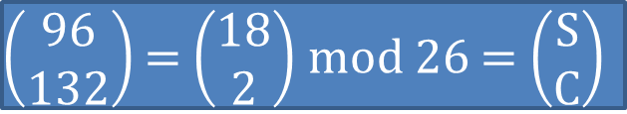
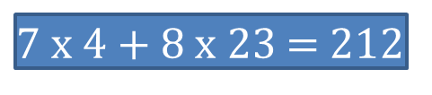
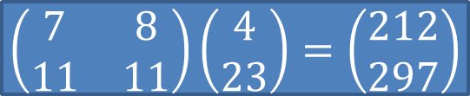
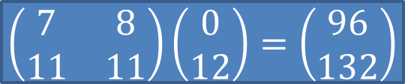
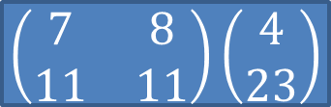
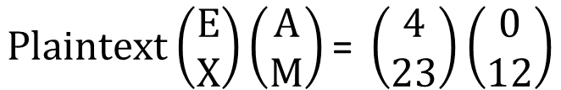
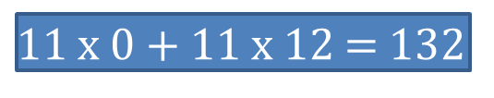
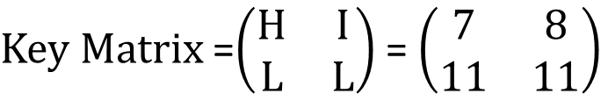
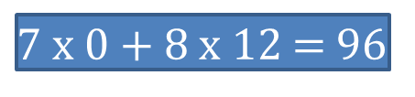
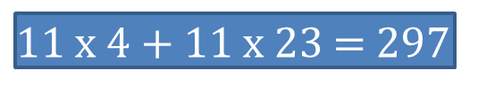
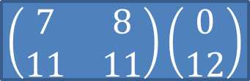
Hill Cipher Encryption (Cont…)
$Key Matrix$=$\left(\begin{matrix}H & I \\ L & L\end{matrix}\right)$ = $\left(\begin{matrix}7 & 8 \\ 11 & 11\end{matrix}\right)$
$$Plaintext\left(\begin{matrix}E \\ X\end{matrix}\right)\left(\begin{matrix}A \\ M\end{matrix}\right)\text{= }\left(\begin{matrix}4 \\ 23\end{matrix}\right)\left(\begin{matrix}0 \\ 12\end{matrix}\right)$$
C=PK mod 26
$$\left(\begin{matrix}7 & 8 \\ 11 & 11\end{matrix}\right)\left(\begin{matrix}4 \\ 23\end{matrix}\right)$$
$$\left(\begin{matrix}7 & 8 \\ 11 & 11\end{matrix}\right)\left(\begin{matrix}0 \\ 12\end{matrix}\right)$$
$7$ x 4 + 8 x 23 = 212
$7$ x 0 + 8 x 12 = 96
$11$ x 4 + 11 x 23 = 297
$11$ x 0 + 11 x 12 = 132
$$\left(\begin{matrix}7 & 8 \\ 11 & 11\end{matrix}\right)\left(\begin{matrix}4 \\ 23\end{matrix}\right)=\left(\begin{matrix}212 \\ 297\end{matrix}\right)$$
$$\left(\begin{matrix}7 & 8 \\ 11 & 11\end{matrix}\right)\left(\begin{matrix}0 \\ 12\end{matrix}\right)=\left(\begin{matrix}96 \\ 132\end{matrix}\right)$$
$\left(\begin{matrix}212 \\ 297\end{matrix}\right)$= $\left(\begin{matrix}4 \\ 11\end{matrix}\right)$ mod 26 = $\left(\begin{matrix}E \\ L\end{matrix}\right)$
$\left(\begin{matrix}96 \\ 132\end{matrix}\right)$= $\left(\begin{matrix}18 \\ 2\end{matrix}\right)$ mod 26 = $\left(\begin{matrix}S \\ C\end{matrix}\right)$
Ciphertext = “ELSC”

Slide 55
Hill Cipher Decryption
Step:1 Find Inverse of key matrix
Step:2 Multiply the Multiplicative Inverse of the Determinant by the Adjoin Matrix
Step:3 Multiply inverse key matrix with ciphertext matrix to obtain plaintext matrix
P=CK⁻¹ mod 26

Slide 56
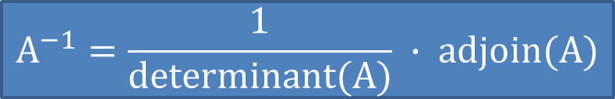
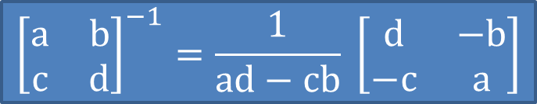
Step: 1 Inverse of key matrix
2 X 2 inverse of matrix
$${\left[\begin{matrix}a & b \\ c & d\end{matrix}\right]}^{−1}=\frac{1}{ad−cb} \left[\begin{matrix}d & −b \\ −c & a\end{matrix}\right]$$
3 X 3 inverse of matrix
$$A^{−1}=\frac{1}{determinant(A)} ∙ adjoin(A)$$

Slide 57
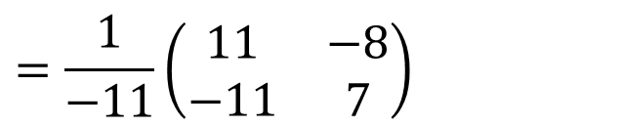
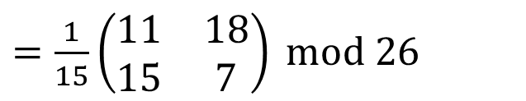
Step: 1 Inverse of key matrix
$$Inverse Key Matrix={\left(\begin{matrix}7 & 8 \\ 11 & 11\end{matrix}\right)}^{−1}=\frac{1}{77−88} \left(\begin{matrix}11 & −8 \\ −11 & 7\end{matrix}\right)$$
$$=\frac{1}{−11}\left(\begin{matrix}11 & −8 \\ −11 & 7\end{matrix}\right)$$
-11 mod 26 = 15
Because, modulo for negative number is = N- (B%N)
= 26 – (11%26)
$=\frac{1}{15}\left(\begin{matrix}11 & 18 \\ 15 & 7\end{matrix}\right) mod 26$

Slide 58
Step: 2 Modular (Multiplicative) inverse
The inverse of a number A is 1/A since A * 1/A = 1
e.g. the inverse of 5 is 1/5
In modular arithmetic we do not have a division operation.
The modular inverse of A (mod C) is A⁻¹
(A * A⁻¹) ≡ 1 (mod C)
Example:
The modular inverse of A mod C is the A⁻¹ value that makes
A * A⁻¹ mod C = 1
A = 3, C = 11
Since (3*4) mod 11 = 1, 4 is modulo inverse of 3
A = 10, C = 17 , A⁻¹ = ?
12

Slide 59
Step 2: Modular (Multiplicative) inverse
Determinants’ multiplicative inverse Modulo 26
Determinant | 1 | 3 | 5 | 7 | 9 | 11 | 15 | 17 | 19 | 21 | 23 | 25
Inverse Modulo 26 | 1 | 9 | 21 | 15 | 3 | 19 | 7 | 23 | 11 | 5 | 17 | 25
$=\frac{1}{15}\left(\begin{matrix}11 & 18 \\ 15 & 7\end{matrix}\right) mod 26$
Multiplicative inverse of $\frac{1}{15}$ is 7

Slide 60
Step 2: Multiply with adjoin of matrix
$$=7\left(\begin{matrix}11 & 18 \\ 15 & 7\end{matrix}\right)=\left(\begin{matrix}77 & 126 \\ 105 & 49\end{matrix}\right)=\left(\begin{matrix}25 & 22 \\ 1 & 23\end{matrix}\right) mod 26$$
$$=thus, if K=\left(\begin{matrix}7 & 8 \\ 11 & 11\end{matrix}\right) then K^{−1}=\left(\begin{matrix}25 & 22 \\ 1 & 23\end{matrix}\right)$$

Slide 61
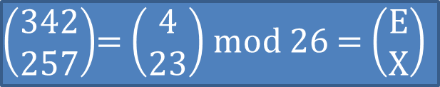
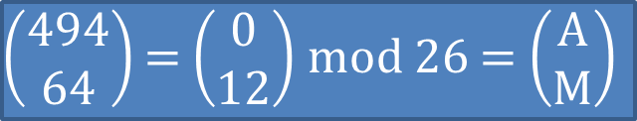
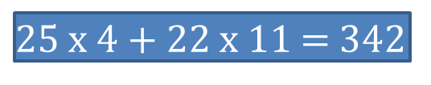
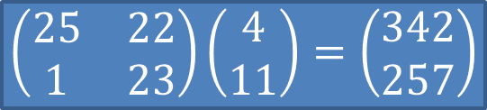
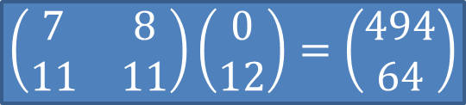
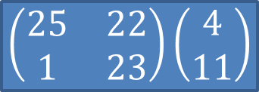
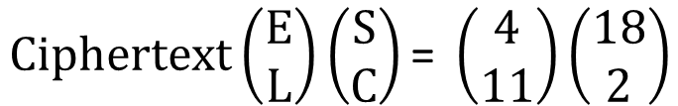
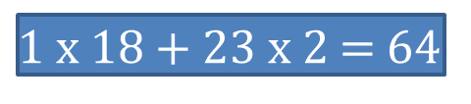
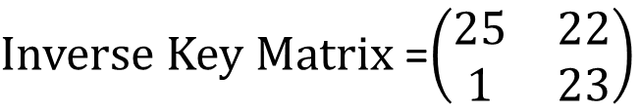
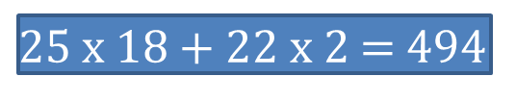


Hill Cipher Encryption (Cont…)
$Inverse Key Matrix$=$\left(\begin{matrix}25 & 22 \\ 1 & 23\end{matrix}\right)$
$$Ciphertext\left(\begin{matrix}E \\ L\end{matrix}\right)\left(\begin{matrix}S \\ C\end{matrix}\right)\text{= }\left(\begin{matrix}4 \\ 11\end{matrix}\right)\left(\begin{matrix}18 \\ 2\end{matrix}\right)$$
P=CK⁻¹ mod 26
$$\left(\begin{matrix}25 & 22 \\ 1 & 23\end{matrix}\right)\left(\begin{matrix}4 \\ 11\end{matrix}\right)$$
$$\left(\begin{matrix}25 & 22 \\ 1 & 23\end{matrix}\right)\left(\begin{matrix}18 \\ 2\end{matrix}\right)$$
$25$ x 4 + 22 x 11 = 342
$25$ x 18 + 22 x 2 = 494
$1$ x 4 + 23 x 11 = 257
$1$ x 18 + 23 x 2 = 64
$$\left(\begin{matrix}25 & 22 \\ 1 & 23\end{matrix}\right)\left(\begin{matrix}4 \\ 11\end{matrix}\right)=\left(\begin{matrix}342 \\ 257\end{matrix}\right)$$
$$\left(\begin{matrix}7 & 8 \\ 11 & 11\end{matrix}\right)\left(\begin{matrix}0 \\ 12\end{matrix}\right)=\left(\begin{matrix}494 \\ 64\end{matrix}\right)$$
$\left(\begin{matrix}342 \\ 257\end{matrix}\right)$= $\left(\begin{matrix}4 \\ 23\end{matrix}\right)$ mod 26 = $\left(\begin{matrix}E \\ X\end{matrix}\right)$
$\left(\begin{matrix}494 \\ 64\end{matrix}\right)$= $\left(\begin{matrix}0 \\ 12\end{matrix}\right)$ mod 26 = $\left(\begin{matrix}A \\ M\end{matrix}\right)$
Plaintext = “EXAM”

Slide 62
Substitution Techniques
Caesar Cipher
Monoalphabetic Cipher
Playfair Cipher
Hill Cipher
Polyalphabetic Ciphers
One-Time Pad

Slide 63
5) Polyalphabetic Cipher
Monoalphabetic cipher encoded using only one fixed alphabet
Polyalphabetic cipher is a substitution cipher in which the cipher alphabet for the plain alphabet may be different at different places during the encryption process.
Vigenere cipher
Vernam cipher

Slide 64

Plaintext
Key
PT = HELLO
KEY = GMGMG
CT = NQRXU

Slide 65
Vigenere Cipher
Keyword : DECEPTIVE
Key : DECEPTIVEDECEPTIVEDECEPTIVE
Plaintext : WEAREDISCOVEREDSAVEYOURSELF
Ciphertext : ZICVTWQNGRZGVTWAVZHCQYGLMGJ
$$C= \left(P_{1}+K_{1},P_{2}+K_{2}, …P_{m}+K_{m}\right)mod 26$$
$$P= \left(C_{1}−K_{1},C_{2}−K_{2}, …C_{m}−K_{m}\right)mod 26$$
An analyst looking at only the ciphertext would detect the repeated sequences VTW at a displacement of 9 and make the assumption that the keyword is either three or nine letters in length.
This system is referred as an autokey system
Keyword : DECEPTIVE
Key : DECEPTIVEWEAREDISCOVEREDSAV
Plaintext : WEAREDISCOVEREDSAVEYOURSELF

Slide 66

Vernam Cipher
The ciphertext is generated by applying the logical XOR operation to the individual bits of plaintext and the key stream.

Slide 67
Substitution Techniques
Caesar Cipher
Monoalphabetic Cipher
Playfair Cipher
Hill Cipher
Polyalphabetic Ciphers
One-Time Pad

Slide 68
One time pad
The one-time pad, which is a provably secure cryptosystem, was developed by Gilbert Vernam in 1918.
The message is represented as a binary string (a sequence of 0’s and 1’s using a coding mechanism such as ASCII coding.
The key is a truly random sequence of 0’s and 1’s of the same length as the message.
message =‘IF’
then its ASCII code =(1001001 1000110)
key = (1010110 0110001)
Encryption:
1001001 1000110 plaintext
1010110 0110001 key
0011111 1110110 ciphertext

Slide 69


Slide 70
Transposition Techniques
A transposition cipher does not substitute one symbol for another, instead it changes the location of the symbols.
The simplest such cipher is the rail fence technique, in which the plaintext is written down as a sequence of diagonals and then read off as a sequence of rows.
For example, to send the message “Meet me at the park” to Bob, Alice writes
She then creates the ciphertext “MEMATEAKETETHPR”.

Slide 71
Rail fence technique
A more complex scheme is to write the message in a rectangle, row by row, and read the message off, column by column, but permute the order of the columns.
The order of the columns then becomes the key to the algorithm.
Key: 4 3 1 2 5 6 7
Plaintext: a t t a c k p
o s t p o n e
d u n t i l t
w o a m x y z
Ciphertext: TTNAAPTMTSUOAODWCOIXKNLYPETZ

Slide 72
Cryptography and Cryptanalysis
Cryptography and Cryptanalysis
Cryptography is the study of the design of techniques for ensuring the secrecy and/or authenticity of information
Cryptanalysis deals with the defeating such techniques to recover information, or forging information that will be accepted as authentic
Notes:
either "writing" or a "field of study"
Calligraphy
Geography
cinematography
autobiography

Slide 73
Cryptographic Algorithms
Cryptographic algorithms and protocols can be grouped into four main areas
Cryptographic algorithms and protocols
Symmetric encryption
Asymmetric encryption
Data integrity algorithms
Authentication protocols
Data integrity algorithms used to protect blocks of data, such as messages, from alteration.
Authentication Protocols are schemes based on the use of cryptographic algorithms designed to authenticate the identity of entities.
Symmetric encryption used to secure the contents of blocks or streams of data of any size, including messages, files, encryption keys, and passwords
Asymmetric encryption used to conceal small blocks of data, such as encryption keys and hash function values, which are used in digital signatures.

Slide 74
Security Objectives
Security objectives for information and computing services are Confidentiality, Integrity, Availability, Authenticity, Accountability.
Confidentiality:
Data confidentiality: Assures that private or confidential information is not made available or disclosed to unauthorized individuals.
Privacy: Assures that individuals control what information related to them may be collected and stored and by whom and to whom that information may be disclosed.

Slide 75
Security Objectives (Cont…)
Integrity:
Data integrity: Assures that information and programs are changed only in a specified and authorized manner.
System integrity: Assures that a system performs its intended function in an unimpaired manner, free from deliberate or inadvertent unauthorized manipulation of the system.
Availability: Assures that systems work promptly and service is not denied to authorized users.

Slide 76
Security Objectives (Cont…)
Authenticity:
The property of being genuine and being able to be verified and trusted; confidence in the validity of a transmission, a message, or message originator.
This means verifying that each input arriving at the system came from a trusted source.
Accountability:
The security goal that generates the requirement for actions of an entity to be traced uniquely to that entity.
This supports nonrepudiation, deterrence, fault isolation, intrusion detection and prevention, and after-action recovery and legal action.

Slide 77
Threat and Attack
Threat: A potential for violation of security, which exists when there is a circumstance, capability, action, or event that could crack security and cause harm. That is, a threat is a possible danger that might exploit a vulnerability.
Attack: An violation on system security that derives from an intelligent threat; that is, an intelligent act that is a calculated attempt to avoid security services and violate the security policy of a system.

Slide 78


